Slide 2
Methodology
500 telephone interviews with registered Minnesota voters
Interviews conducted between January 6-8, 2013
Interviews on both landlines and cell phones
Margin of sampling error of +/- 4.4%
Bipartisan research team of Fairbank, Maslin, Maullin, Metz & Associates (D) and Public Opinion Strategies (R)
Comparisons to prior MEP statewide surveys dating back to 2002
Selected findings from survey research in Minnesota conducted in January 2012 and February 2010 by the Re-AMP coalition; in October 2012 by Mining Truth; and nationally in June 2012 by NRDC
Some percentages may not sum to 100% due to rounding
Notes:
1

Slide 3
Regional Definitions
NORTHEAST
Kittson
Roseau
Lake Of The Woods
NORTHWEST
Marshall
Koochiching
Pennington
Beltrami
Red Lake
Cook
Polk
Clearwater
Itasca
St Louis
Lake
Norman
Mahnomen
Hubbard
Cass
Clay
Becker
Wadena
Crow Wing
Aitkin
Carlton
Wilkin
Otter Tail
Todd
Morrison
Mille Lacs
Pine
Grant
Douglas
Kanabec
Traverse
Benton
Big Stone
Stevens
Pope
Stearns
Sherburne
Isanti
Swift
Anoka
Chisago
TWIN CITIES
Chippewa
Kandiyohi
Meeker
Wright
Washington
Lac Qui Parle
Hennepin
Ramsey
Yellow Medicine
Renville
Mcleod
Carver
Dakota
SOUTH
Sibley
Scott
Lincoln
Lyon
Redwood
Nicollet
Le Sueur
Rice
Goodhue
Wabasha
Brown
Pipestone
Murray
Cottonwood
Watonwan
Blue Earth
Waseca
Steele
Dodge
Olmsted
Winona
Rock
Nobles
Jackson
Martin
Faribault
Freeborn
Mower
Fillmore
Houston

Slide 4
The Political Context

Slide 5
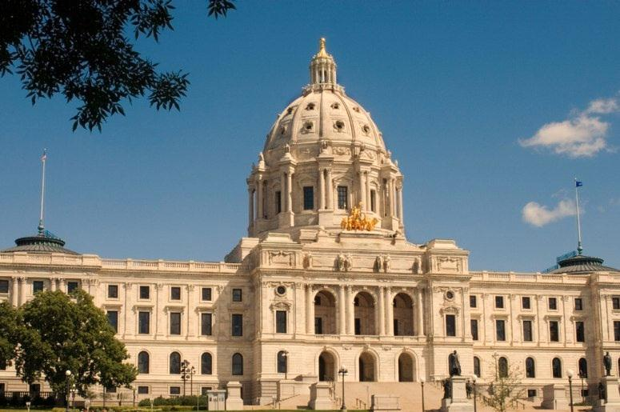
The outlook in Minnesota continues to improve.
Generally speaking, do you think that things in your part of Minnesota are on the right track or on the wrong track?
Party ID
 | Right Track | Wrong Track | DK/NA
Democrat | 82% | 9% | 9%
Independent | 46% | 34% | 20%
Republican | 40% | 48% | 12%
Q3.

Slide 6
“Right direction” is at its highest level since 2004.
Generally speaking, do you think that things in your part of Minnesota are on the right track or on the wrong track?
Q3.

Slide 7
Clean Energy

Slide 8
Minnesotans clearly prefer an energy strategy that prioritizes renewables.
Preferred Approach to Energy | % Choosing
Reducing our need for oil and coal by increasing energy efficiency and expanding our use of clean, renewable energy that can be generated in the US | 67%
Drilling and digging for more oil and coal wherever we can find it in the US | 26%
Both/Neither/DK/NA | 7%
17. Which of the following do you think should be the highest priority for meeting Minnesota’s energy needs:

Slide 9
This is especially true among Democrats, but a plurality of Republicans also hold this opinion.
Statements | All Voters | Dem. | Ind. | Rep.
Reducing our need for oil and coal by increasing energy efficiency and expanding our use of clean, renewable energy that can be generated in the US | 67% | 87% | 57% | 46%
Drilling and digging for more oil and coal wherever we can find it in the US | 26% | 9% | 34% | 42%
Both/Neither/DK/NA | 7% | 4% | 9% | 12%
17. by Party

Slide 10
A preference for more use of renewables is shared across all regions of the state.
Statements | All Voters | North-East | North-West | South | Twin Cities
Reducing our need for oil and coal by increasing energy efficiency and expanding our use of clean, renewable energy that can be generated in the US | 67% | 63% | 65% | 65% | 69%
Drilling and digging for more oil and coal wherever we can find it in the US | 26% | 33% | 29% | 26% | 22%
Both/Neither/DK/NA | 7% | 4% | 6% | 9% | 9%
17. by Region

Slide 11
Support for a wide range of proposals to promote clean energy and energy efficiency has been remarkably stable.
Total Support
78%
72%
77%
77%
82%
78%
83%
75%
73%
75%
76%
75%
70%
*Strengthening residential and commercial building codes to require increased energy efficiency
*Providing incentives to increase the use of small-scale solar projects at the sites of homes and businesses, and public buildings
*^Ensuring that 40% of the state’s electricity comes from renewable sources
*Increasing state government investment in the development of clean, renewable energy sources
^Phasing out older coal plants in Minnesota and replacing them with greater use of renewable energy and energy efficiency
18. I would like to read you some ideas related to energy that might be proposed by people in Minnesota. Please tell me whether it sounds like something you would support or oppose. ^Slightly Worded Differently/*Split Sample

Slide 12
We saw last spring that majorities support increased use of wind and solar.
Total Support | Total Oppose
84% | 13%
87% | 10%
86% | 8%
85% | 14%
52% | 42%
46% | 15%
54% | 41%
5a/b/c/d/e/f/i. Here is a list of specific sources of energy. Please tell me whether you would support or oppose increasing use of that source of energy to meet your state’s future needs. *Split Sample

Slide 13
More than seven in ten voters back a 10 percent solar requirement.
Some people have proposed requiring that Minnesota get at least 10 percent of its electricity needs from solar power by the year 2030. Does this sound like something you would favor or oppose?
Total Favor 74%
Total Oppose 24%
Q19. Split Sample

Slide 14
Democrats, Independents and Republicans support a 10 percent solar requirement…
Some people have proposed requiring that Minnesota get at least 10 percent of its electricity needs from solar power by the year 2030. Does this sound like something you would favor or oppose?
Response | All Voters | Dem. | Ind. | Rep.
Total Favor | 74% | 93% | 66% | 54%
Strongly Favor | 40% | 53% | 34% | 25%
Somewhat Favor | 34% | 39% | 32% | 29%
Total Oppose | 24% | 6% | 31% | 42%
DK/NA | 3% | 1% | 3% | 3%
Q19. Split Sample by Party

Slide 15
…as do at least two-thirds of voters in every part of the state.
Some people have proposed requiring that Minnesota get at least 10 percent of its electricity needs from solar power by the year 2030. Does this sound like something you would favor or oppose?
Response | All Voters | North-East | North-West | South | Twin Cities
Total Favor | 74% | 87% | 67% | 72% | 75%
Strongly Favor | 40% | 55% | 30% | 47% | 37%
Somewhat Favor | 34% | 32% | 37% | 25% | 38%
Total Oppose | 24% | 13% | 27% | 25% | 24%
DK/NA | 3% | 0% | 6% | 3% | 2%
Q19. Split Sample by Region

Slide 16
Most voters would be willing to pay a little extra on their energy bills to promote clean energy and energy efficiency.
Which of the following is the MOST you would be willing to pay per month on your electric bill in order promote clean energy and energy efficiency?
Total $6 and Up 56%
Q15.

Slide 17
Voters of all parties are willing to pay more for clean energy and energy efficiency.
Willingness to Pay by Party Identification
(% of Sample)
(33%)
(42%)
(24%)
Q15. Which of the following is the MOST you would be willing to pay per month on your electric bill in order promote clean energy and energy efficiency?

Slide 18
Clarifying the monthly cost impact of the requirement has no impact on support.
Does this sound like something you would favor or oppose?
74%
24%
10%/ $1 per Month
73%
24%
Q19/Q20 & Q21/Q22. Split Sample

Slide 19
Research last year also showed that voters believe increasing the use of renewable energy and energy efficiency projects will create new jobs.
Which of the following comes closer to your point of view: Increasing the use of clean, renewable energy sources like wind and solar power…
Which of the following comes closer to your point of view: Energy efficiency projects like weatherizing and insulating buildings, and upgrading appliances and technology in homes and businesses ….
Will create new jobs
Will not affect jobs
Will cost jobs
All/None/DK
Q9/10.

Slide 20
Candidate profiles that emphasize health and job creation are the top-ranked among all voters.
(HEALTH) One candidate says that using more clean energy sources and being more energy efficient will give us healthier air, reduce asthma and lung disease, and ultimately save lives. That’s why many medical and health groups, like the American Lung Association, support efforts to transition to cleaner energy.
(BOLD ACTION) One candidate says investing in clean energy means more than just wind and solar power – it means new clean and efficient vehicles, and energy-efficient equipment, technology, and infrastructure. It means creating jobs in design, manufacturing, construction, and many other fields across our economy. This is the kind of bold action we need to get our economy growing again.
(CREATING JOBS) One candidate says that our state already employs thousands of people in clean energy jobs, from engineers to construction workers to port workers to administrative assistants. These are jobs that pay a living wage, and many cannot be outsourced. Encouraging use of clean energy, will continue to create more local jobs.
(STATE INVESTMENTS) One candidate says major state investments in clean energy, efficiency, transit and infrastructure can improve communities, help households and small businesses save money, and generate more private investment. Acting now on clean energy can help our towns and cities, build local jobs, and improve our quality of life.
82%
85%
85%
83%
16c/e/f/j. Here are some statements that a candidate for State Legislature might offer about energy issues in your state. Please tell me whether you would view the candidate making that statement more favorably or less favorably. Split Sample

Slide 21
Conservation Funding and Defense

Slide 22
Two-thirds of voters believe that environmental laws should be toughened or better-enforced.
Which of the following statements comes closest to your view of government regulations of the environment in Minnesota?
Total Made Tougher or Better Enforced:
67%
Q5.

Slide 23
Seven in ten voters also express concern about rollbacks of laws to protect the environment.
Rollbacks of laws that protect our land, air and water
Total Concerned 70%
Total Not Too/Not Concerned 25%
4d. Would you say that you are very concerned, somewhat concerned, not too concerned, or not at all concerned about each of the following: Rollbacks of laws that protect our land, air and water.

Slide 24
Introduction of Proposal to Shift Amendment Funding
I would like to ask you about a state constitutional amendment approved by Minnesota voters in 2008. It increased the state sales tax by three-eighths of one percent to provide dedicated funding for clean water, land protection, and wildlife habitat, arts education and parks and trails.
Some legislators may propose using money from the amendment to replace funding for existing water and land conservation programs in the state budget.

Slide 25
As we have seen in prior years, seven in ten voters resolutely support using the amendment to enhance conservation funding.
Statements | 2009 | 2010 | 2012 | 2013
In these tough economic times, elected officials must be reminded that we want to protect Minnesota's Great Outdoors for the long-term. We must not let elected officials raid constitutionally dedicated conservation funds to solve short-term state budget problems. | 70% | 66% | 71% | 70%
Given the state’s budget crisis, it is appropriate for state legislators to use money from this amendment to prevent cuts to existing programs to protect water and land | 21% | 25%
Given tough economic times, it is appropriate for state legislators to use money from this amendment to prevent cuts to existing programs to protect water and land |  |  | 24% | 25%
Both/Neither/DK/NA | 9% | 9% | 5% | 4%
7. I am going to read you two statements about this issue. Please tell me which one comes closest to your own view, even if neither of the statements matches your views exactly.

Slide 26
Nearly nine in ten voters would prefer to see amendment dollars allocated by need, rather than by population.
Funding for land protection and wildlife habitat should be distributed wherever in Minnesota it will benefit natural areas and wildlife habitat the most, even if it is farther away from where most people live
Funding for land protection and wildlife habitat should be designated for protecting natural areas and wildlife habitat close to where the most people live, even though it may result in less habitat being protected
Both/Neither/DK/NA
OR
9. This next question deals only with the portion of the amendment funds set aside for Land Protection and Wildlife Habitat. Please tell me which of the following statements comes closest to your opinion. Split Sample

Slide 27
That sentiment holds equally true in both urban and rural areas.
Preference for Distribution of Amendment Dollars, By County
Statements | 11 Largest Counties | Others
Funding for land protection and wildlife habitat should be distributed wherever in Minnesota it will benefit natural areas and wildlife habitat the most, even if it is farther away from where most people live | 89% | 81%
Funding for land protection and wildlife habitat should be designated for protecting natural areas and wildlife habitat close to where the most people live, even though it may result in less habitat being protected | 9% | 16%
Both/Neither/DK/NA | 2% | 3%
9. This next question deals only with the portion of the amendment funds set aside for Land Protection and Wildlife Habitat. Please tell me which of the following statements comes closest to your opinion. Split Sample

Slide 28
Clean Water

Slide 29
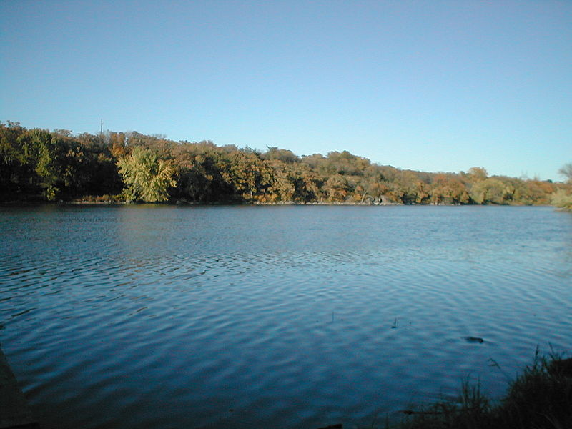
Prior to a series of policy questions, survey respondents were given some background on the current state of water pollution in Minnesota.
Currently, 40% of Minnesota’s lakes, rivers and streams that are tested do not meet basic health standards. The top cause of this is non-regulated run-off and pollution from agriculture.

Slide 30
Voters strongly believe that water quality funding should be focused on the most effective projects…
I am going to read you several pairs of statements about water pollution caused by farms in Minnesota. Please choose the statement that comes closest to your opinion.
State funding to improve water quality should be focused on the most effective projects to reduce pollution, wherever they are located | 67%
OR
State funding to improve water quality should be spread evenly throughout the state, and not just to areas with the most pollution | 28%
Q10c. ½ Sample

Slide 31
Support for sulfide mining has dropped dramatically since last year.
As you may know, new mines are being proposed near the Boundary Waters and Lake Superior. These are different from the traditional Minnesota iron ore mines. These new sulfide mining operations would be used to extract copper, nickel, and other precious metals from underground rock formations containing sulfur. Based on this description, would you favor or oppose these new mines?
Total Favor 39%
Total Oppose 48%
Q13. (*2012 Language slightly different.)

Slide 32
There has been a steady decline in support for sulfide mining since 2009.
13.. Based on this description, would you favor or oppose these new mines?/Do you favor or oppose sulfide mining in Minnesota? (*Language slightly different.)

Slide 33
The same pattern is evident when we narrow our focus to “strong” supporters and opponents.
13.. Based on this description, would you favor or oppose these new mines?/Do you favor or oppose sulfide mining in Minnesota? (*Language slightly different.)

Slide 34
Voters continue to back various restrictions on sulfide mining.
Acidic or toxic pollution released into the environment during the operation of these mines has the potential to pollute drinking water. Here are a series of ideas that have been proposed to help prevent damage from sulfide mines. Please tell me whether each sounds like something you would favor or oppose.
Total Favor.
89%
85%
86%
81%
85%
84%
80%
Requiring sulfide mine operators, before they begin construction, to put up necessary cash to prevent pollution during operation, closure, and post-closure of the mine
Requiring better enforcement of existing regulations on mine operators, and resisting attempts to weaken these regulations.
Establishing tougher regulations on mining to be certain that Minnesota’s land and water are protected.
Requiring that before being allowed to mine in Minnesota, companies first prove that a similar mine has been operated elsewhere without contaminating the local rivers, lakes, and streams for at least ten years after closure
Q15.

Slide 35
DAVID METZ
1999 Harrison St., Suite 1290 Oakland, CA 94612 Phone (510) 451-9521
Fax (510) 451-0384
Dave@FM3research.com
LORI WEIGEL
17145 West 62nd Circle
Golden, CO 80403
Phone (303) 324-7655
Fax (303) 433-4253
lori@pos.org

